Slide 1
Dimensionality Reduction Using sci-kit learn

Slide 2
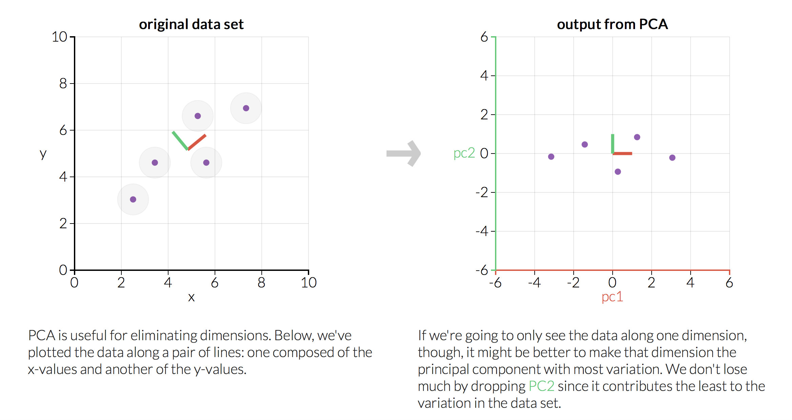
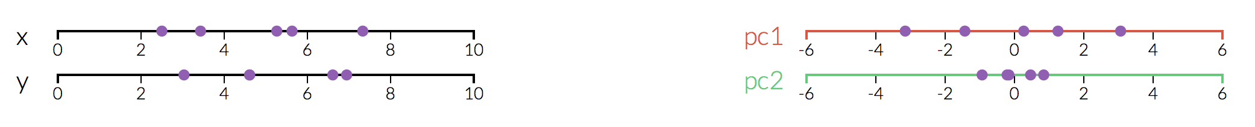
Principal Component Analysis Visualization
Victor Powell and Lewis Lehe, http://setosa.io/ev/principal-component-analysis/, accessed 21.03.2019
Notes:
PCA takes data points with particular “features” or “dimensions” and determines the basis that maximizes the variance in data in fewest “new” dimensions (PCs)
Rotating and scaling the original dimensions
End up with PCs that are linear combinations of the original dimensions
Number of PCs = number of original dimensions in input
More information contained in smaller number of dimensions

Slide 3
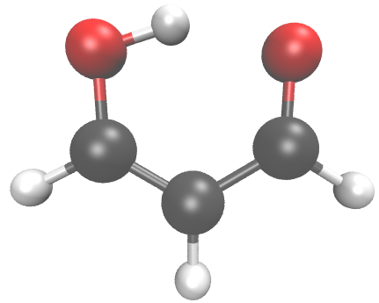
Principal Component Analysis Visualization
Victor Powell and Lewis Lehe, http://setosa.io/ev/principal-component-analysis/, accessed 21.03.2019
Notes:
PCA takes data points with particular “features” or “dimensions” and determines the basis that maximizes the variance in data in fewest “new” dimensions (PCs)
Rotating and scaling the original dimensions
End up with PCs that are linear combinations of the original dimensions
Number of PCs = number of original dimensions in input
More information contained in smaller number of dimensions

Slide 4
Principal Component Analysis Visualization
z₈
z₉
z₁
y₉
x₈
y₈
x₉
y₁
z₆
x₁
z₂
z₇
y₆
y₂
z₄
z₃
x₆
x₂
y₇
y₄
x₃
y₃
x₇
x₄
z₅
y₅
x₅
3N Dimensions
(x₁, y₁, z₁, …, x_{N}, y_{N}, z_{N})
Victor Powell and Lewis Lehe, http://setosa.io/ev/principal-component-analysis/, accessed 21.03.2019
Notes:
PCA takes data points with particular “features” or “dimensions” and determines the basis that maximizes the variance in data in fewest “new” dimensions (PCs)
Rotating and scaling the original dimensions
End up with PCs that are linear combinations of the original dimensions
Number of PCs = number of original dimensions in input
More information contained in smaller number of dimensions

Slide 5
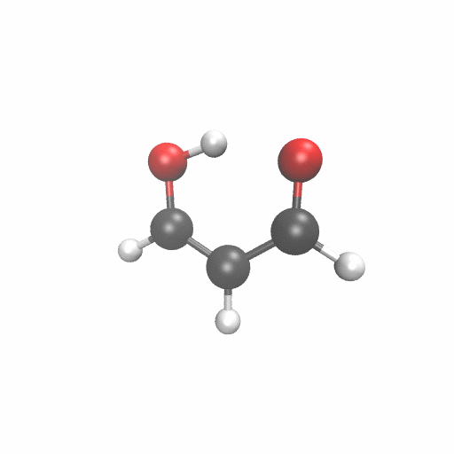
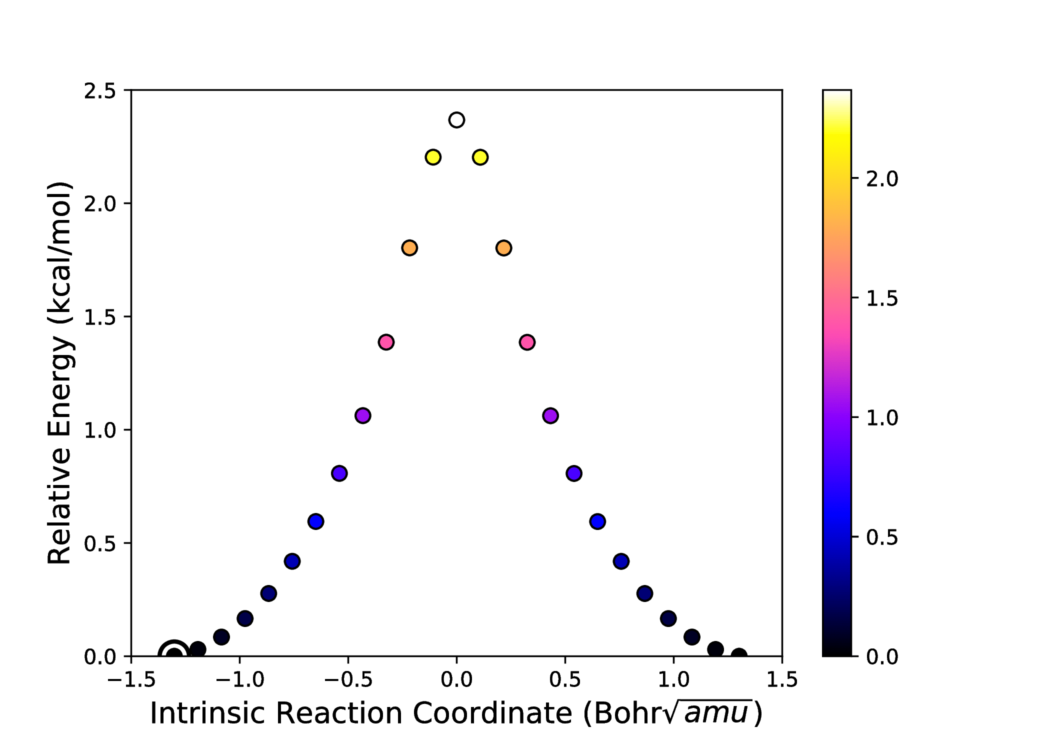
Example Chemical System
Malonaldehyde H⁺-transfer
n structures
Malonaldehyde H⁺-transfer
z_{i}
y_{i}
x_{i}
N atoms
Intrinsic Reaction Coordinate (IRC)
Hare, S. R.; Bratholm, L.; Glowacki, D. R.; Carpenter, B. K.; Manuscript in progress.

Slide 6
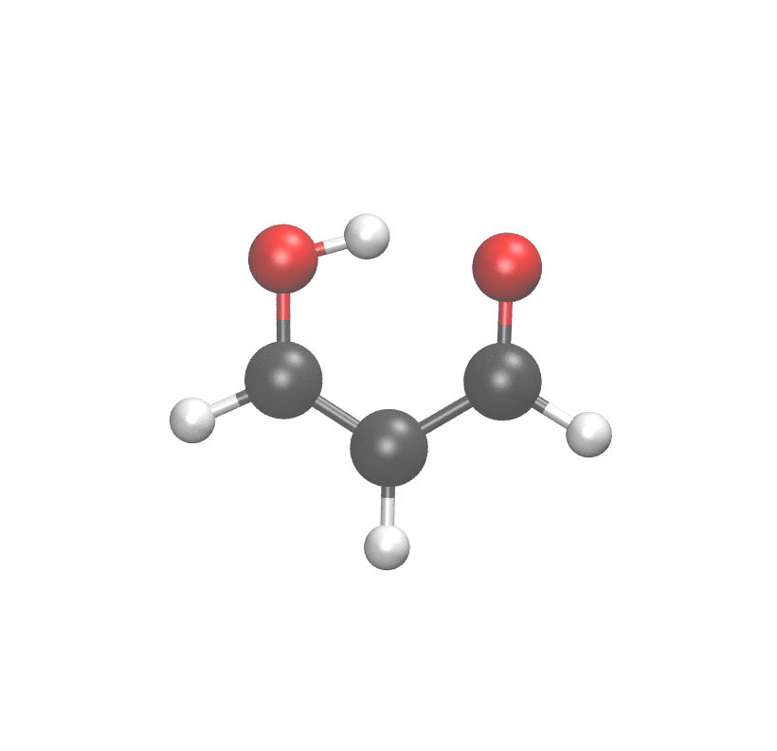
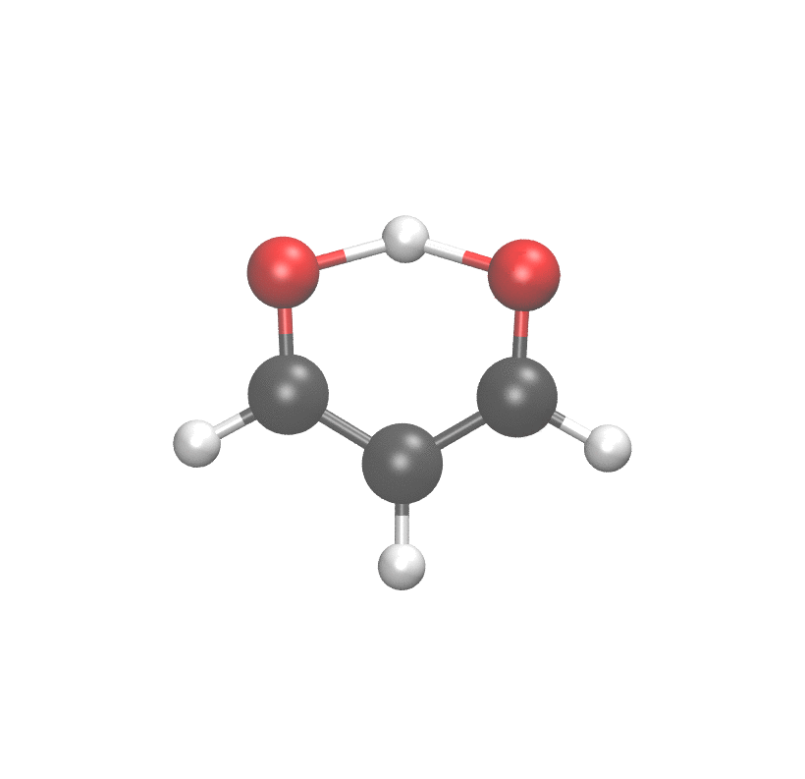
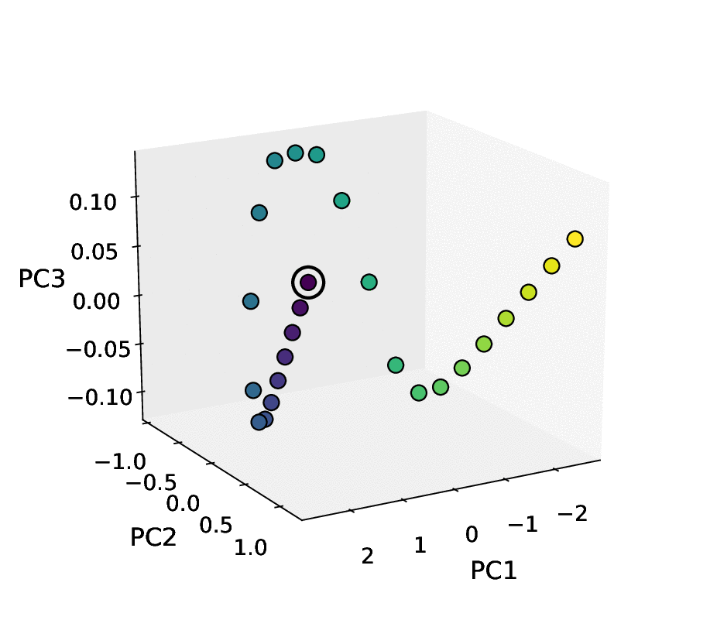
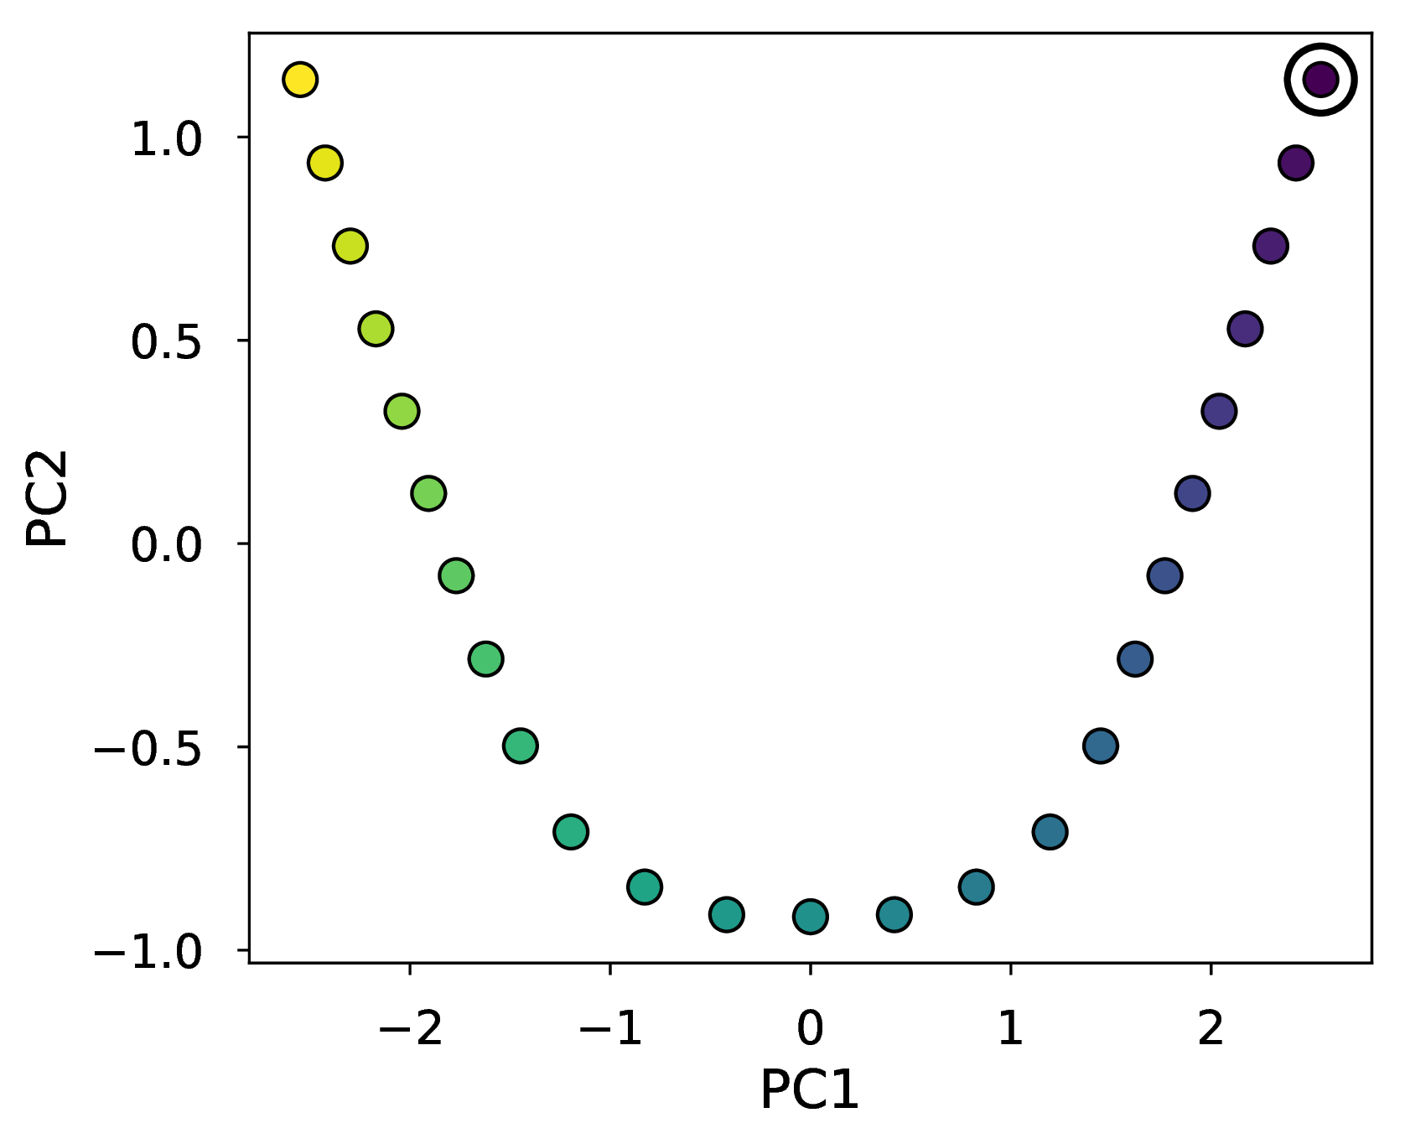
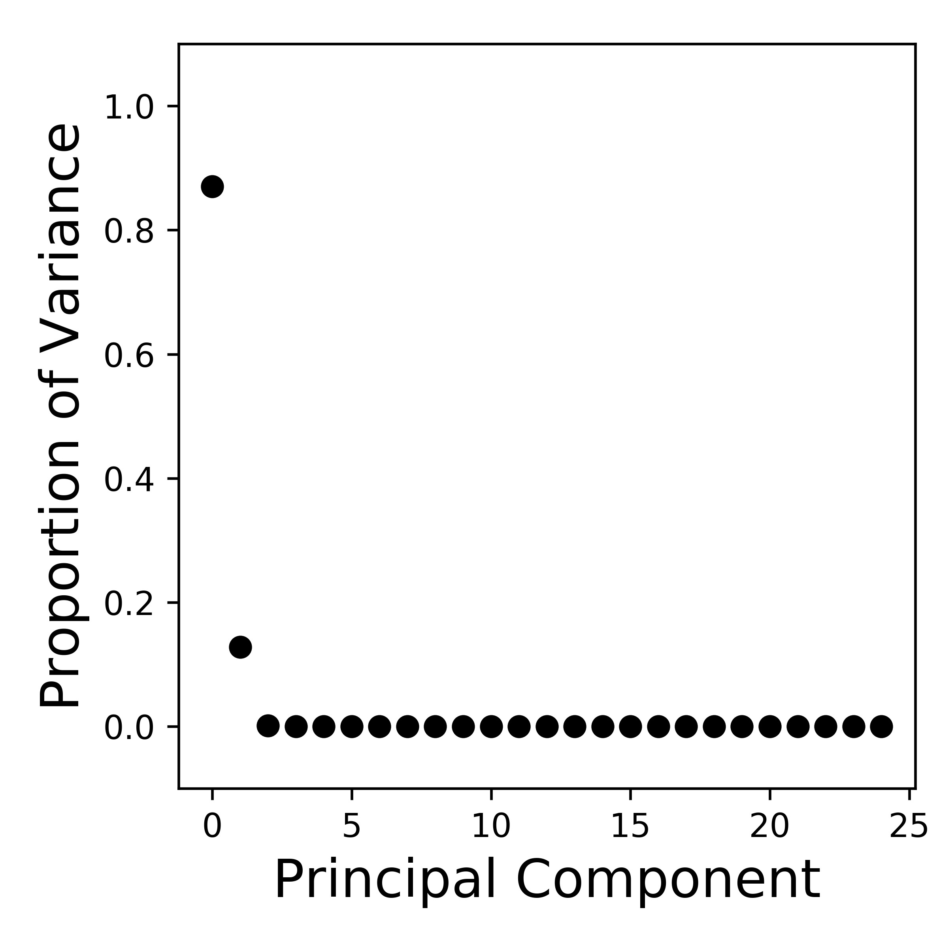
Malonaldehyde H⁺-transfer
Dimensionality Reduction Output
IRC
Principal Component 1 (PC1)
Principal Component 2 (PC2)
Goodness of Fit
G.o.F. (1-dim) = 87.0%
G.o.F. (2-dim) = 99.8%
Hare, S. R.; Bratholm, L.; Glowacki, D. R.; Carpenter, B. K.; Manuscript in progress.
Notes:
Points are no longer colored by energy, but by time
Purple → Yellow

Slide 7
Your Task(s)
Pre-Processing
Processing
Plotting
Matrix of
Data
PCs to
Plot
xyz file
n samples x p features
Plot(s) of top 2-3 PCs

